Slide 1
Ch 4.2
Exponential Functions

Slide 2
4.2 Exponential Functions ( Pg 340)
We define an exponential function to be one of the form
f(x) = ab^{x} , where b > 0 and b = 1, a = 0
If b < 0 , b^{x} will be negative then b is not a real number for some
value of x
**For example b = -3 , b^{x} = (-3) ^{x} , then f( ½) = ( -3) ^{½,} is an imaginary
number
**We also exclude b=1 as a base
If b= 1, f(x) = 1 ^{x} = 1 which is constant function
*** Some examples of exponential functions are
f(x) = 5^{x ,}
P(t)= 250(1.7)^{t}
g(t) = 2.4(0.3) ^{t}

Slide 3
To find Y -intercept
f(x) = a.b ^{x}
f(0) = a.b⁰ = a.1 = a when x= 0
The constant a is the y-intercept of the exponential function because x = 0
For examples , we find y-intercept
f(x) = 5^{x}
f(0)= 5⁰ = 1, when x = 0
When t = 0
P(t)= 250(1.7)^{t}
P(0) = 250(1.7) ⁰ = 250
G(t) = 2.4(0.3) ^{t}
G(0) = 2.4(0.3) ⁰ = 2.4

Slide 4
Graphs of Exponential Functions has two characteristics depending on whether the base , b, is greater than 1 or less than 1
g(x)= ^{x}
f(x)= 2^{x}
Here b = 2 > 1 Here b = ½ < 1
x | g(x)
-3 | 8
-2 | 4
-1 | 2
0 | 1
1 | 1/2
2 | 1/4
3 | 1/8
x | f(x)
-3 | 1/8
-2 | 1/4
-1 | 1/2
0 | 1
1 | 2
2 | 4
3 | 8
Increasing function Decreasing Function
10
(3, 8)
(-3, 8)
8
4
2
5
(2, 4)
(-1, ½)
( 1,2)
(- 2, 4)
(1, ½)
(-2, 1/4)
(-1, 2)
(2, 1/4)
(-3, 1/8)
( 0,1)
( 0,1)
(3, 1/8)
- 5 5
- 5 5

Slide 5
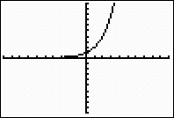
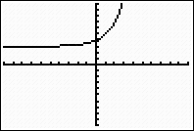
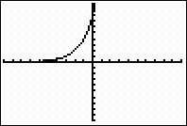
Transformations of Exponential Functions Using Graphing Calculator Pg342
Standard Window
Y1 = 2^X Y2 = 2^X +3 Y3 = 2^(X+ 3)
Basic Graph Vertical Translation of 3 units up Translated 3 units to the left
y = 2^{x} y = 2^{x} + 3 y = 2^{x+3}
Vertical asymptote y = 3 instead of y= 0

Slide 6
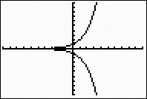
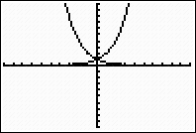
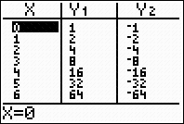
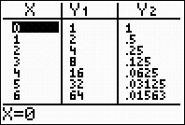
Reflections of Graph
The graph of y = - f(x) is the reflection
The graph of y = f(-x) is the reflection of the graph of y = f(x)
of the graph of y = f(x) about the x-axis about the y-axis
f(x) = 2 ^{x}
g(x) = ^{x}
f(x) = 2 ^{x}
x
g(x) = = 2 ^{- x}
y = -f(x)
Y1 = 2 ^{x}, Y2 = -2^{x}
Y1 = 2^{x}
,Y2 = 2 ^{- x}

Slide 7
Compare Exponential and Power Functions
Power Functions Exponential Functions
General formula h(x) = kx^{p} f(x) = ab^{x}
Description Variable base and Constant base and variable
constant exponent Exponent
Example h(x) = 2x³ f(x) = 2(3^{x})
Although both involve expressions with exponent, it is the location of
the variable that makes the difference
These two families of functions have very different properties, as
well

Slide 8
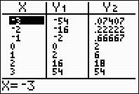
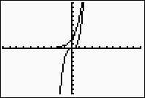
Compare the power function h(x) = 2x³ and the exponential function f(x) = 2(3^{x})
Enter Y1= h(x) = 2x³, and Y2 = f(x) = 2(3^{x})
f(x)= 2(3^{x})
h(x) = 2x³

Slide 9
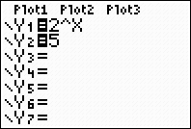
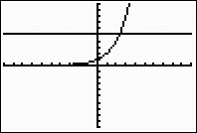
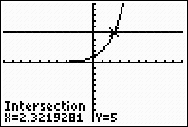
Graphical solution of Exponential Equations by Graphing Calculator ( Ex- 6, Pg –346)
Find the approximate solution to the equation 2 ^{x} = 5
Enter y₁ ₌ 2 ^{x} Zoom 6 Trace
y₂ = 5
2 ^{x}

Slide 10
Ex 4.2( Pg 348)- No 4
Make a table of values and graph each pair of functions by hand
on the domain [ -3, 3]. Describe the similarities and differences
between the two graphs
4a) F(x) = (1/10)^{x}
b) G(x) = 10 ^{x}
F G
x | F(x) | G(x)
-3 | 1000 | 1/1000
-2 | 100 | 1/100
-1 | 10 | 1/10
-0.5 | -3.2 | -0.32
0 | 1 | 1
0.5 | -0.32 | -3.2
1 | 1/10 | 10
2 | 1/100 | 100
3 | 1/1000 | 1000
Increasing
decreasing
Reflections of each other across y axis
F has Positive xaxis as an asymptote
G has negative x-axis as its asymptote

Slide 11
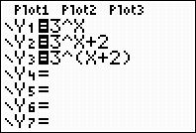
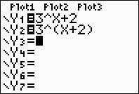
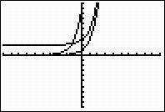
16. a) Use the order of operations to explain why the two functions are different. b) Complete the table of values and graph both functions in the same window. C) Describe each as a transformation of y = 3^{x}
f(x) = 3^{x} + 2, g(x) = 3 ^{x+2}
Functions Graph Table
f(x)
x | y=3^{x} | f(x) | g(x)
-2 | 1/9 | 19/9 | 1
-1 | 1/3 | 7/3 | 3
0 | 1 | 3 | 9
1 | 3 | 5 | 27
2 | 9 | 11 | 81
f(x)
y = 3^{x}
g(x)
g(x)
Graph f is 3^{x} translated 2units up
The graph of g is 3^{x} shifted 2 units left

Slide 12
19. For the given function, evaluate each pair of expressions, Are they equivalent ?
f(x) = 3(5^{x})
a)(f(a+2) and 9f(a)
b) f(2a) and 2f(a)
Solution
f(a+2) = 3(5) ^{a+2} =3(5)ª.5² = 75(5)ª
9f(a) = 9.3(5)ª = 27(5)ª
So f(a+2) and 9f(a) are not equivalent
b) f(2a) = 3(5)^{2a}
2f(a) = 2.3(5)ª
f(2a) and 2f(a) are not eqivalent

Slide 13
24. The graph of g(x) = P_{o}b^{x} is shown in the figure a) Read the value of P₀ from the graph b) Make a short table of values for the function by reading values from the graph. Does your table confirm that the function is exponential ? C) Use your table to calculate the decay factor, b d) Using your answer to parts (a) and ©, write a formula for g(x)
1000
800
600
400
200
Decreasing
0 1 2 3
Solution – a) P_{o} = 1000
b ) The following table confirms that this is exponential. For every unit increase
in x, g(x) is divided by 5
x | 0 | 1 | 2
f(x) | 1000 | 200 | 40
c) By part (b) , the decay factor is b = 1/5
d) g(x) = 1000(1/5) ^{x}

Slide 14
Solve each equation algebraically
27) 5 ^{x + 2} = 25
Solution
25 = ( 5²) = 5
x+ 2 =
x = -2
x =
2
36) 5 ^{x} ^{– x – 4} = 25
Solution
2
25 = 5
x² – x – 4 = 2
x² – x – 6 = 0
(x – 3)(x + 2) = 0
x = 3, x = -2

Slide 15
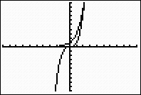
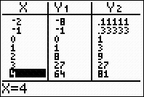
52- Fill in the tables. Graph each pair of functions in the same window. Then answer the questions below
Give the range of f and the range of g
For how many values of x does f(x) = g(x)
Estimate the value(s) of x for which f(x) = g(x).
For what values of x is f(x) < g(x) ?
Which function grows more rapidly for large values of x ?
g(x) f(x)
-3
3
Solution
Range of f : ( - , )
range of g: ( 0, )
Two
x = 2.5, x = 3
( - , 2.5) U ( 3, )
g(x)

